Slide 1
Résumé Questions
Teamwork Members: Emanuel Sérgio Girardi , Vitor Duarte, Luiz Eduardo, Gabriel Rover e Sérgio Felipe Starke.

Slide 2
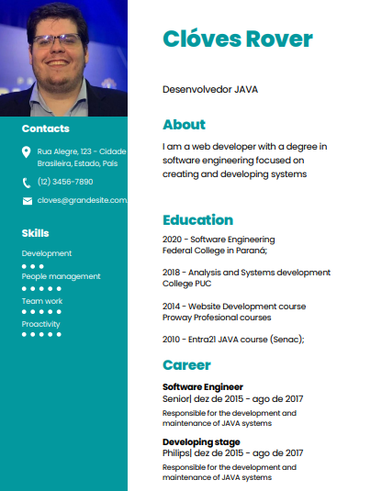
Asks
01 Tell me about yourself. I have worked as a development for two years and as long as I can, I improve my skills in every task that I have.
02 Tell me about your educationa. I graduated in Software Engineering at the Federal College in Paraná; My degree in Software Engineering helped me develop many skills, but, the better one ,is in the teamwork skills.
03 What is your greatest strength? I have extremely strong responsible skills in group job, and I'm also always ready to learn more what evar I need to.
05 Why should we hire you? In a few words, I have years of experience in jobs where it requires concentration and good response under pressure.

Slide 3
Asks
06 Why do you wnat this job? I have Always been passionate about the universe of development and I think I am a great asset to be productive in this enterprise.
07 Why did you leave your last job? I was looking for an opportunity to achievement for a better stability, which I will certainly catch up in this enterprise.
08 What do you think of your previous boss? My last boss and I, worked really well together on our last Project. I learned a lot from my last boss, he taught me how to have good leadership and to value teamwork.
09 What do you know about our company? Based on my research, this company, presents many opportunities for growth, both inside and outside the country. this really caught my attention!

Slide 4
Asks
10 Where do you see yourself in five years? This is a great question and I'm glad you asked. In 5 years I see myself with some goals accomplished. Part of them is being well-developed at a good company. Possibly working abroad.
11 What motivates you? What motivates me: New challenges. I really love my job and being productive. It really motivates me to be better.
12 How do you deal with pressure or stressful situations? I don't have any problems working under pressure. I try to react to situations accordingly, according to what is asked to me.

Slide 5
Asks
13 Do you have any questions for us? Can you tell me a little bit about how works the relationship in the empliers, and if in any time, I can know how is they jobs, I mean, how works the responsibility and what they need to do?
I think that is a great moment to see and understand how can I emprove my work, based in how is the sthandards skills.

Slide 6
Thanks for Watching

